Slide 1

Excel Assessment

Slide 2
Q1:
Removed duplicate files by highlighting the data and removing the supplicate values in the DATA section
In comments section , there are so many blank spaces so I just filled blank spaces with “No comments” using CTRL +G , and then go to blanks and filled it .

Slide 3
Q2:Time analysis
Calculated the time gap using DATEDIF() function and put the publish day and trending date .
Example:
=DATEDIF(publish_date,trending_date,”d”)
Computing the average time gap for a video to become trendy after publishing : 2.30
=AVERAGE(Q2:Q16308)

Slide 4

Category analysis
We calculate engagement rate by (likes+comment)/view
=(H2+J2)/G2
H2 = likes
J2 = comments
G2 = view
Entertainment has the top views and engagement rate

Slide 5
FILTER AND XLOOKUP
=XLOOKUP(B2,Category!B:B,'YouTube data'!Q1:Q16308,0)
We will use XLOOKUP for finding category name corresponding to channel name

Slide 6
TEXT ANALYSIS
I have merged channel titile and video title using CONCAT fucnction
Using
=TEXTJOIN(",",TRUE,FILTER('Q1'!P1:P16308,'Q1'!C1:Q16308 = 'Q5'!A2))
Just use this function to join the comments for the whole videos.

Slide 7
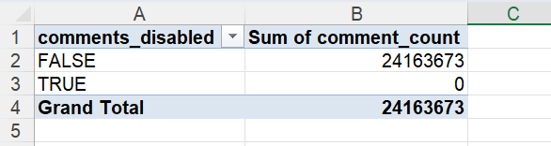
Comment analysis
For the comments are disabled, there can be no comments

Slide 8
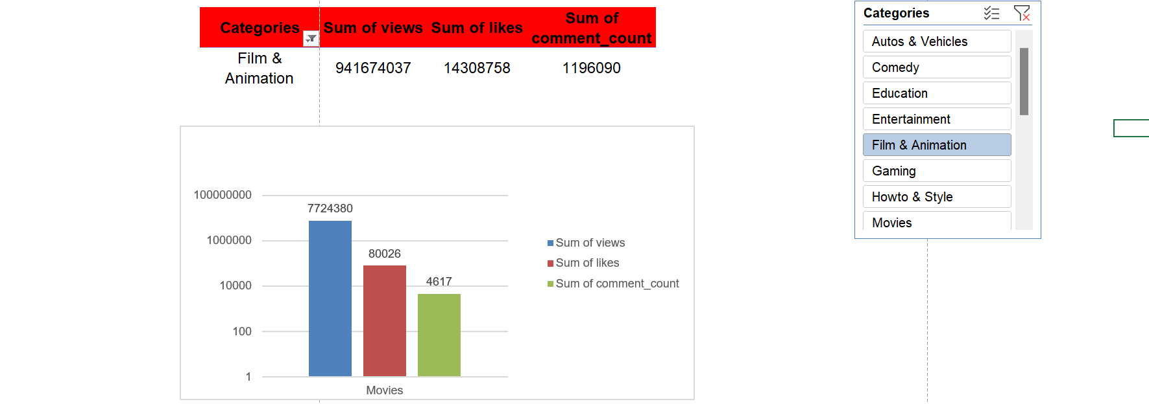
Visual creation

Slide 9
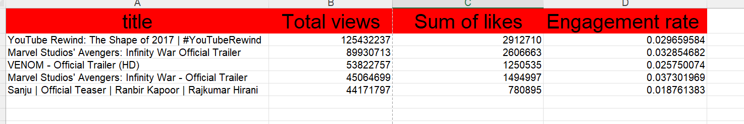
Top 5 videos which has high total views, likes and engagement rate

Slide 10
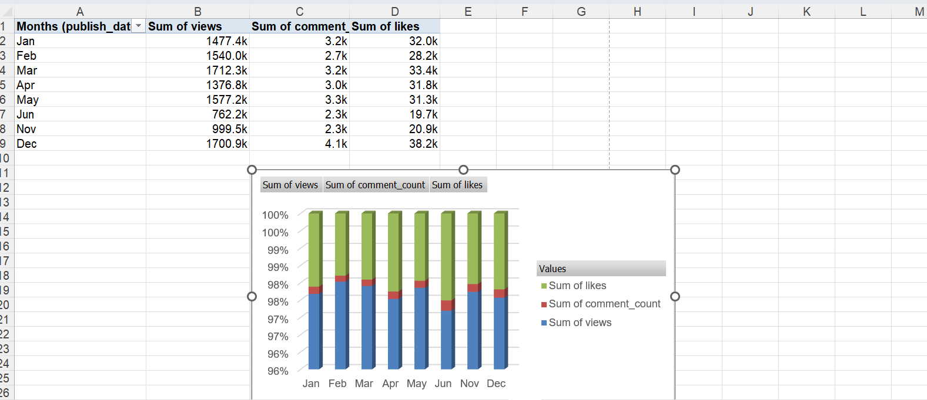
Filtering by condition

Slide 11
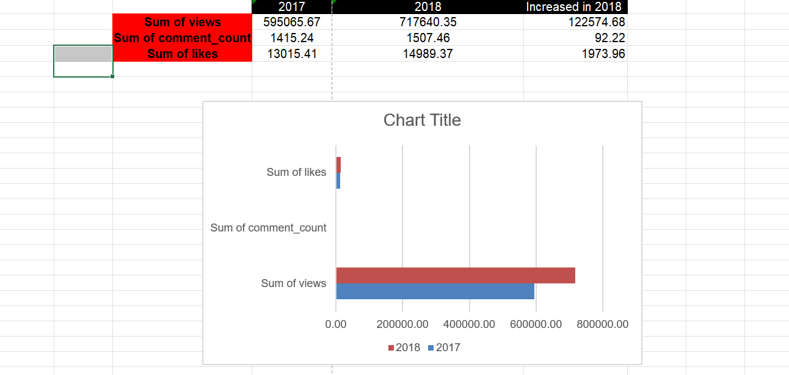
q10

Slide 12
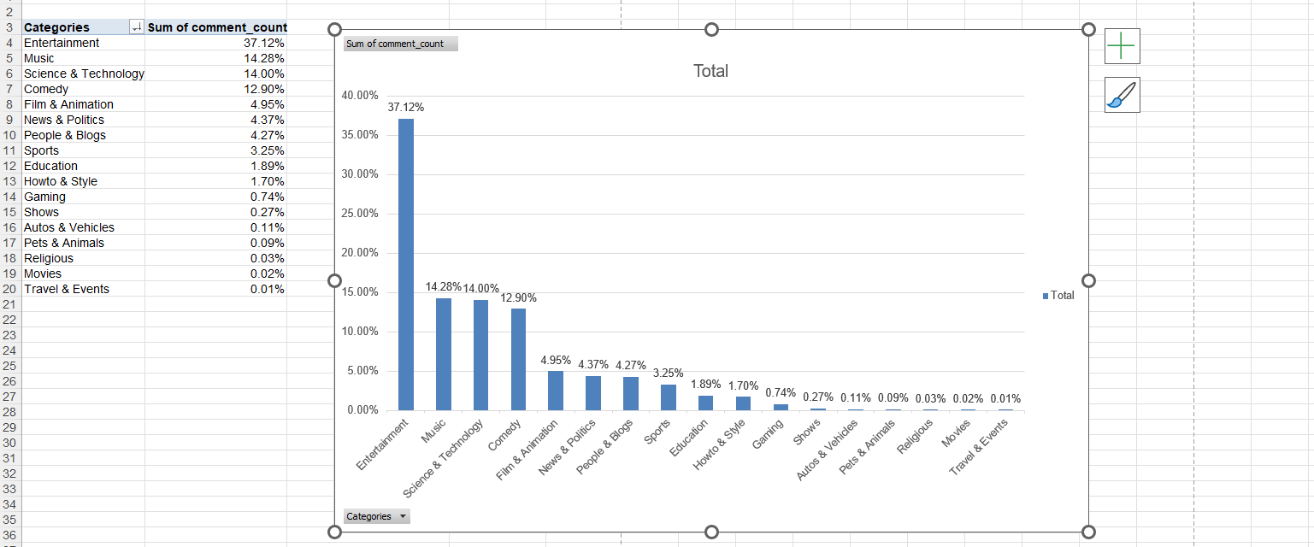
Q13 SENTIMENTAL ANALYSIS

